Slide 1
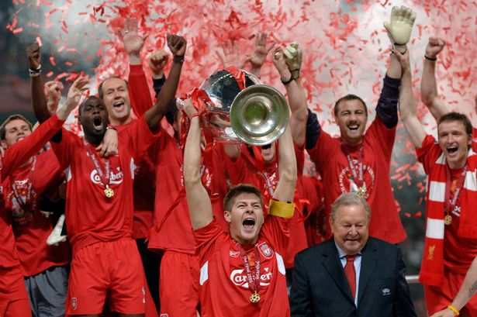
Predicting Upsets in English Premier League Soccer
A Data Science Project by Sam Gottuso

Slide 2

Background
Why is this important?
Why use data science?
What data are we using?
How well do Sport books anyways?
What is an upset?
Notes:
Let’s start with a couple of background slides.

Slide 3
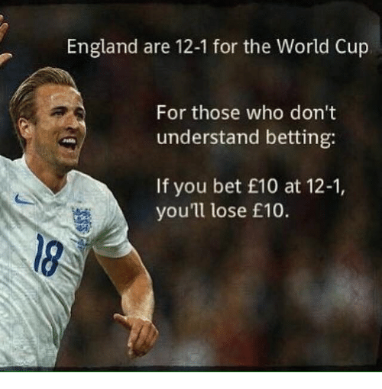
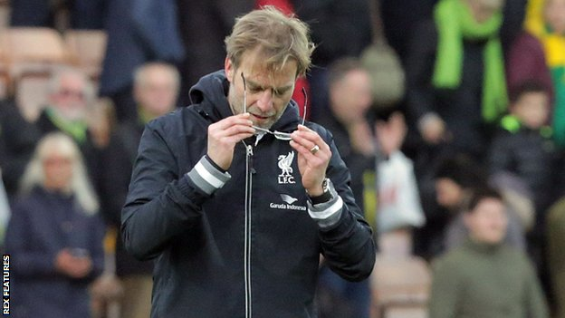
Why is this important and why use data science?
Notes:
Lots of psychological factors--- how do ‘experts’ determine who will win? How is the wisdom of the crowds versus them?
Broadly applicable to other areas of prediction--- we’ll get into this later on next steps/why does it matter
Huge market for it- lots of data points that can help us shape predictions. I only used 15 seasons in 1 league--- so many seasons, so many games.
Lack of predictive power and advanced analytics in soccer

Slide 4
Prediction

Slide 5
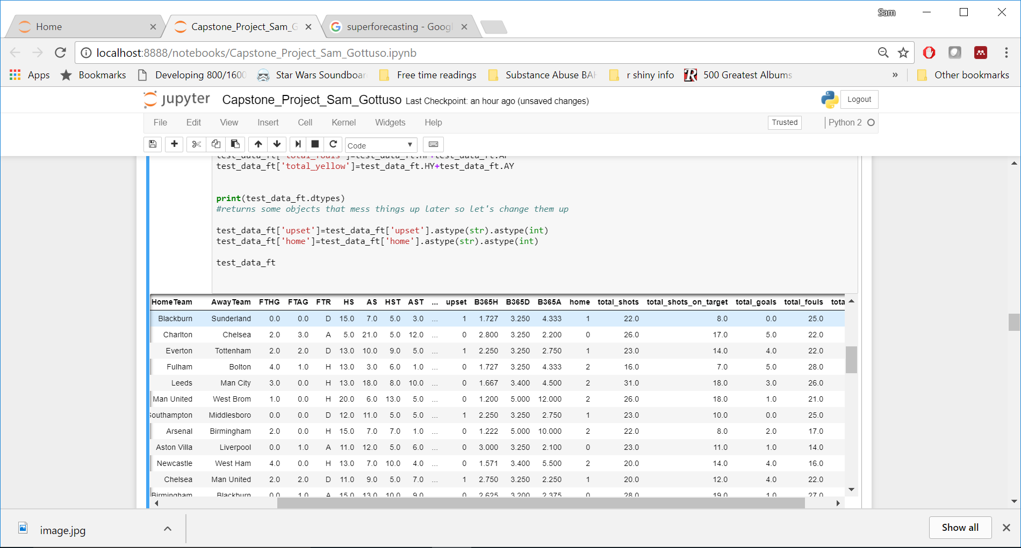
What are we working with?
Notes:
Here’s our data--- we are working with almost 6000 matches over 15 seasons.
Most importantly we are looking at data from each game--- total shots, total shots on target, total goals, fouls, yellow cards and whether the winning team was home or not

Slide 6
Sportbooks schmortbooks
5,926 Games
2,754 Upsets
46.4% games picked correctly

Slide 7
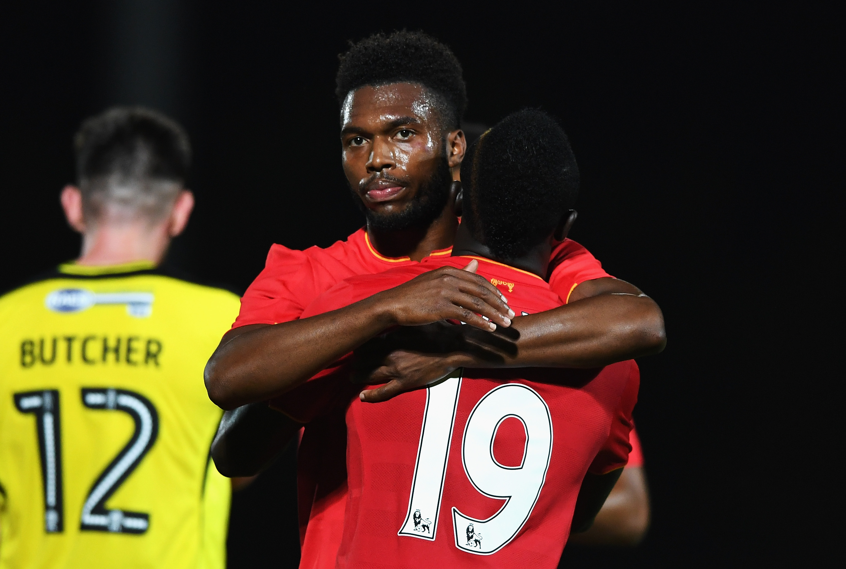
Upset City
Yes even Liverpool loses sometimes
Notes:
Sport books only have to pick right over 33% of the time because they have win/draw/lose options.
We categorized them as either being correct or not correct--- so if a sports book picked a draw as the most likely scenario (lowest odds) and a win occurred than that would be an ‘upset’

Slide 8
Different Analytical Approaches
General process– finding/setting up/cleaning/ the data
Model Selection
Logistic
How to pick the factors?
KNN
How to pick how many neighbors to use.
Notes:
How are we going to go about this?

Slide 9
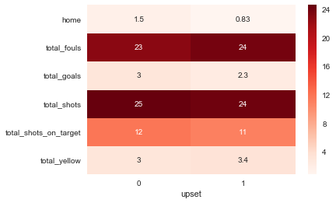
What do our Factors look like?
Notes:
Created a pivot table--- saw the average of all these categories in both upsets and non-upsets
Initial hypothesis--- more defensive games are more likely to produce upsets

Slide 10
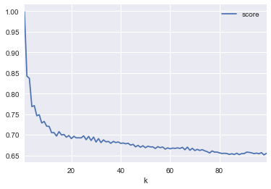
How many neighbors should we use?
Notes:
Graphed all the possible scores for a KNN model from 1-100 nearest neighbors.
Want to stay in the red box– but don’t want to overfit!

Slide 11
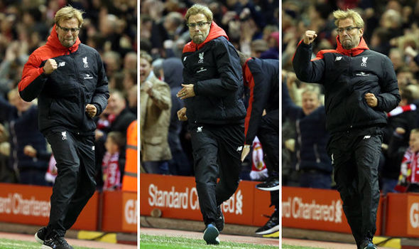
Which
Was
Best?

Slide 12
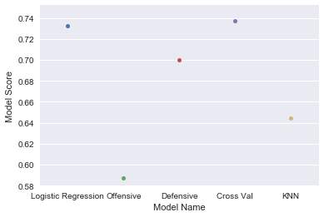
Score by Model

Slide 13
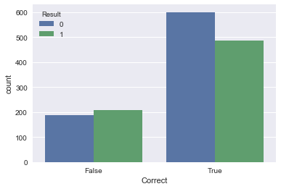
How’d it predict on our testing data?
Notes:
Pretty good! Of the 1432 upsets in our testing data we correctly picked the result of the game 1086 times. Did better on predicting non-upsets (team was probably home) than predicting upsets

Slide 14
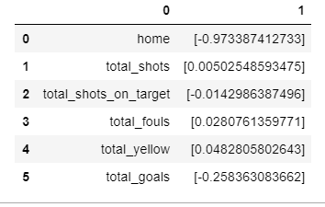
What ended up being important in the model?
Notes:
The initial hypothesis seemed to be correct--- more defensive games (lower goals, more fouls and yellows) lead to more upsets.
Home field advantage also plays a huge role--- upsets are much less likely to happen when it is the home team that won.

Slide 15
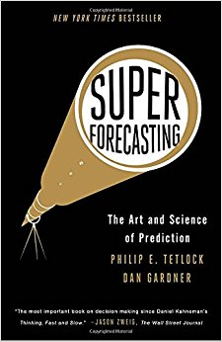
What does this mean?
Psychological analysis of markets.
How to find winners.
Better enjoyment of Sam’s EPL experience.
Notes:
So what does this mean and why should you all care?
Comparision vs superforecasters/intelligence world
Psychological data on how experts pick games... How crowds pick them

Slide 16
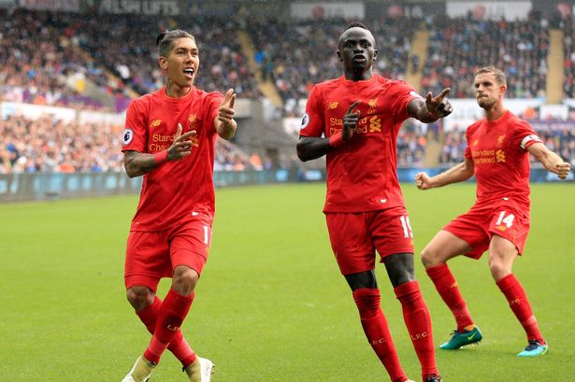
What’s Next?
Notes:
Gather more data from more seasons.
More complex classifications and pre-game data? How can we use season averages for teams to predict upsets?
Is a model better than picking the home team?

Slide 17
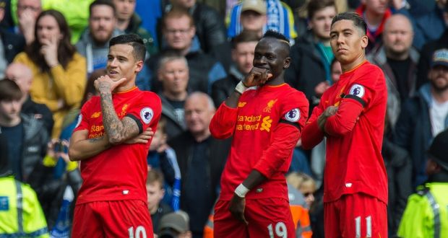
Questions?

